Slide 1
Cyclistic Bike-sharing Analysis (Case Study)
Raj Roshan
20-01-2026
Google Data Analytics Capstone

Slide 2
Maximizing Annual Memberships Insights From Cyclistic Bike-share Data
Welcome to the Cyclistic bike-share analysis case study, where we examine trends and behavior of rider to learn more about how users interact with the service. This study intends to produce useful insights that will support Cyclistic's marketing strategy and assist in converting casual riders into annual members by using Divvy trip data from 2025.

Slide 3
Overview
Objective
To understand how annual members and casual riders use Cyclistic bikes differently.
Business Goal
Provide insights that can help in converting casual riders into annual members.

Slide 4
Business task
Statement:
Analyze Cyclistic bike trip data to identify their usage patterns and trends by comparing the behaviors of annual members and casual riders.
Generate data-driven insights to increase annual memberships.

Slide 5
Data sources
Description:
Utilized Cyclistic's historical trip data from the previous divvy trips of 2019 2025.
Source: Divvy / Cyclistic public bike-share data
Duration: January 2025 – December 2025

Slide 6
Key findings
Ride frequency
Ride duration
Peak usage times
Annual Members: More consistent usage throughout the week, higher usage during weekdays.
Casual Riders: Higher usage during weekends, lower during weekdays.
Annual Members: Peak during morning and evening commutes. Members ride consistently on weekdays
Casual Riders: Peak during midday and weekends.
Annual Members: Member users average 12.3 minutes per ride, suggesting more frequent but shorter trips.
Casual Riders: Casual users average 22.6 minutes per ride, nearly double that of members. Longer rides, often for leisure or exploration.

Slide 7
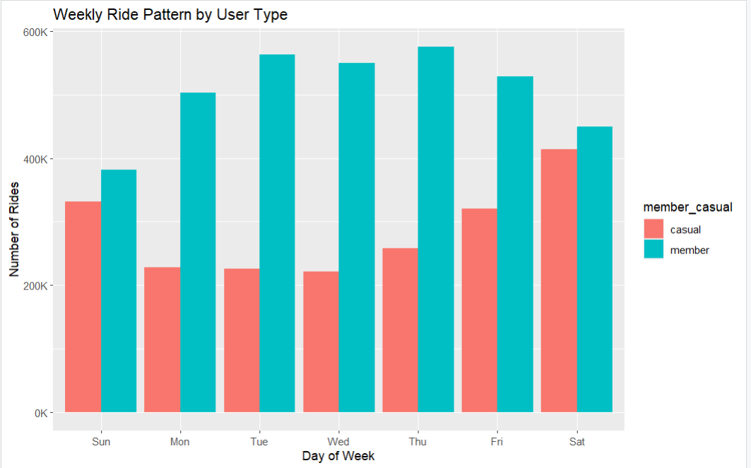

Slide 8
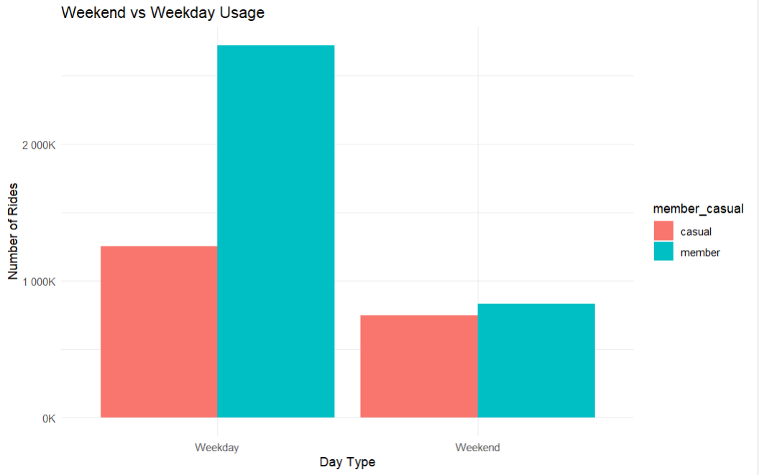

Slide 9
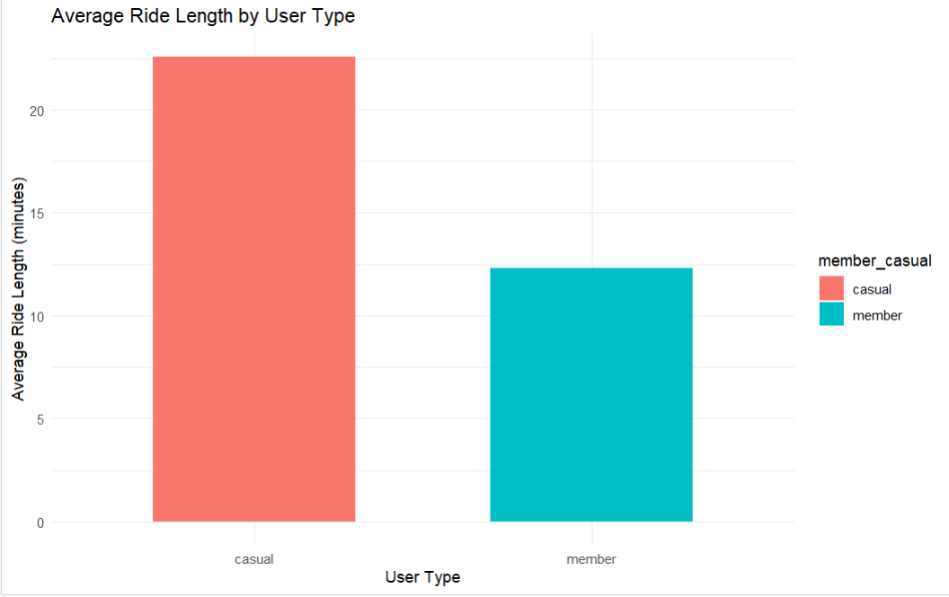

Slide 10
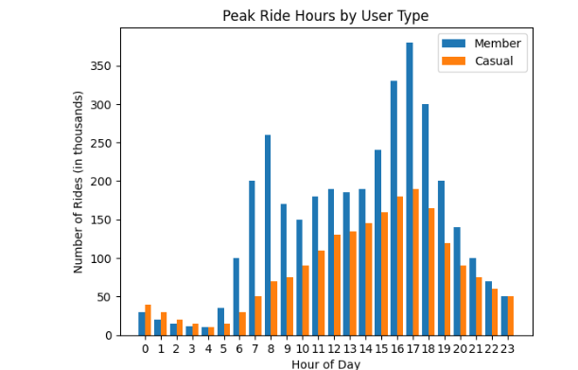

Slide 11
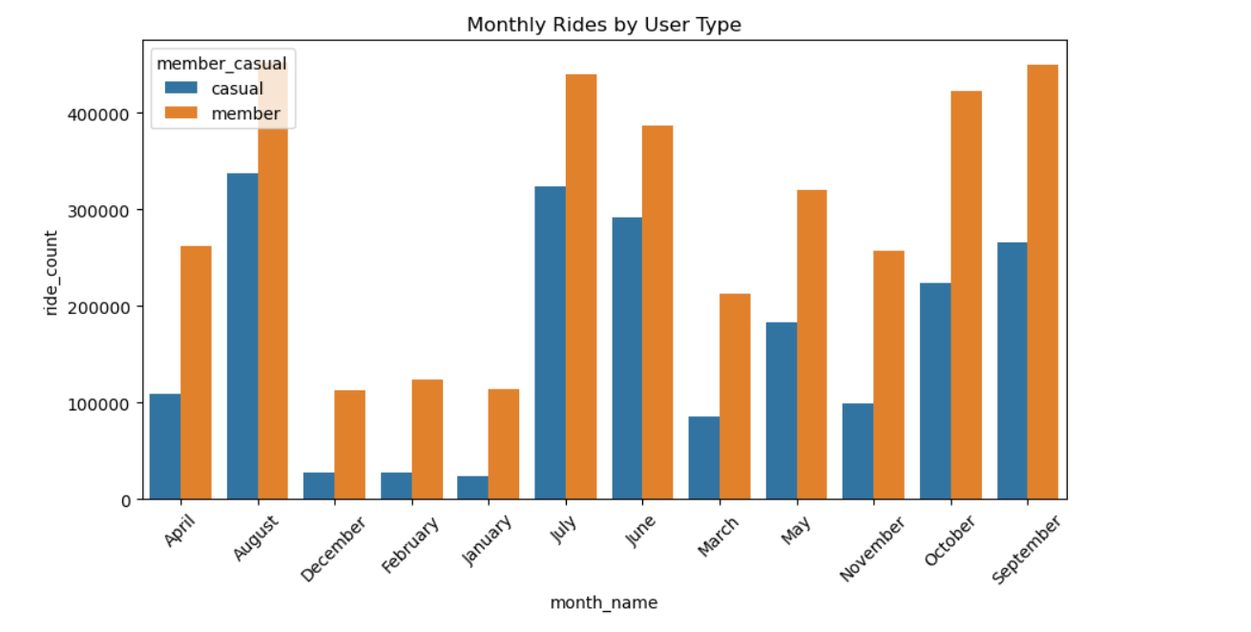

Slide 12
Recommendations
Targeted Marketing Campaign
Enhanced User Experience
Bike Availability
Promote membership benefits at station with high traffic and during peak usage times i.e. weekends and midday.
Promote memberships near tourist & recreational locations
Highlight benefits of annual memberships.
Launch seasonal membership drives.
Introduce features like loyalty programs and seamless membership upgrades.
Add features such as Route suggestions for tourists and membership upgrade option day pass.
Show monthly cost comparison to highlight the saving by using annual membership.
Ensure More bikes at business districts on weekday and More bikes at parks, tourist spots, waterfronts on weekends.
Use electric bike promotions to drive conversions

Slide 13
Conclusion
Summary:
Our analysis clearly shows behavioral differences between casual riders and members. By using these insights, Cyclistic can design targeted marketing strategies to increase overall revenue and effectively convert casual riders into annual members.

Slide 14
Thank you for your attention.
Author
Raj Roshan

